Slide 1
EHDS and AI Act:
Perspectives of a negotiator
Ralf Bendrath
Adviser for
civil liberties, justice and home affairs
Greens/EFA in the European Parliament
Notes:
<Foliennummer>

Slide 2
Peek behind closed doors
I was one of maybe 6 colleagues from political groups, who participated in the negotiations on both EHDS and AIA.
Most of the text is normally negotiated on „technical“ level.
Final political trilogues can be difficult and long.

Slide 4
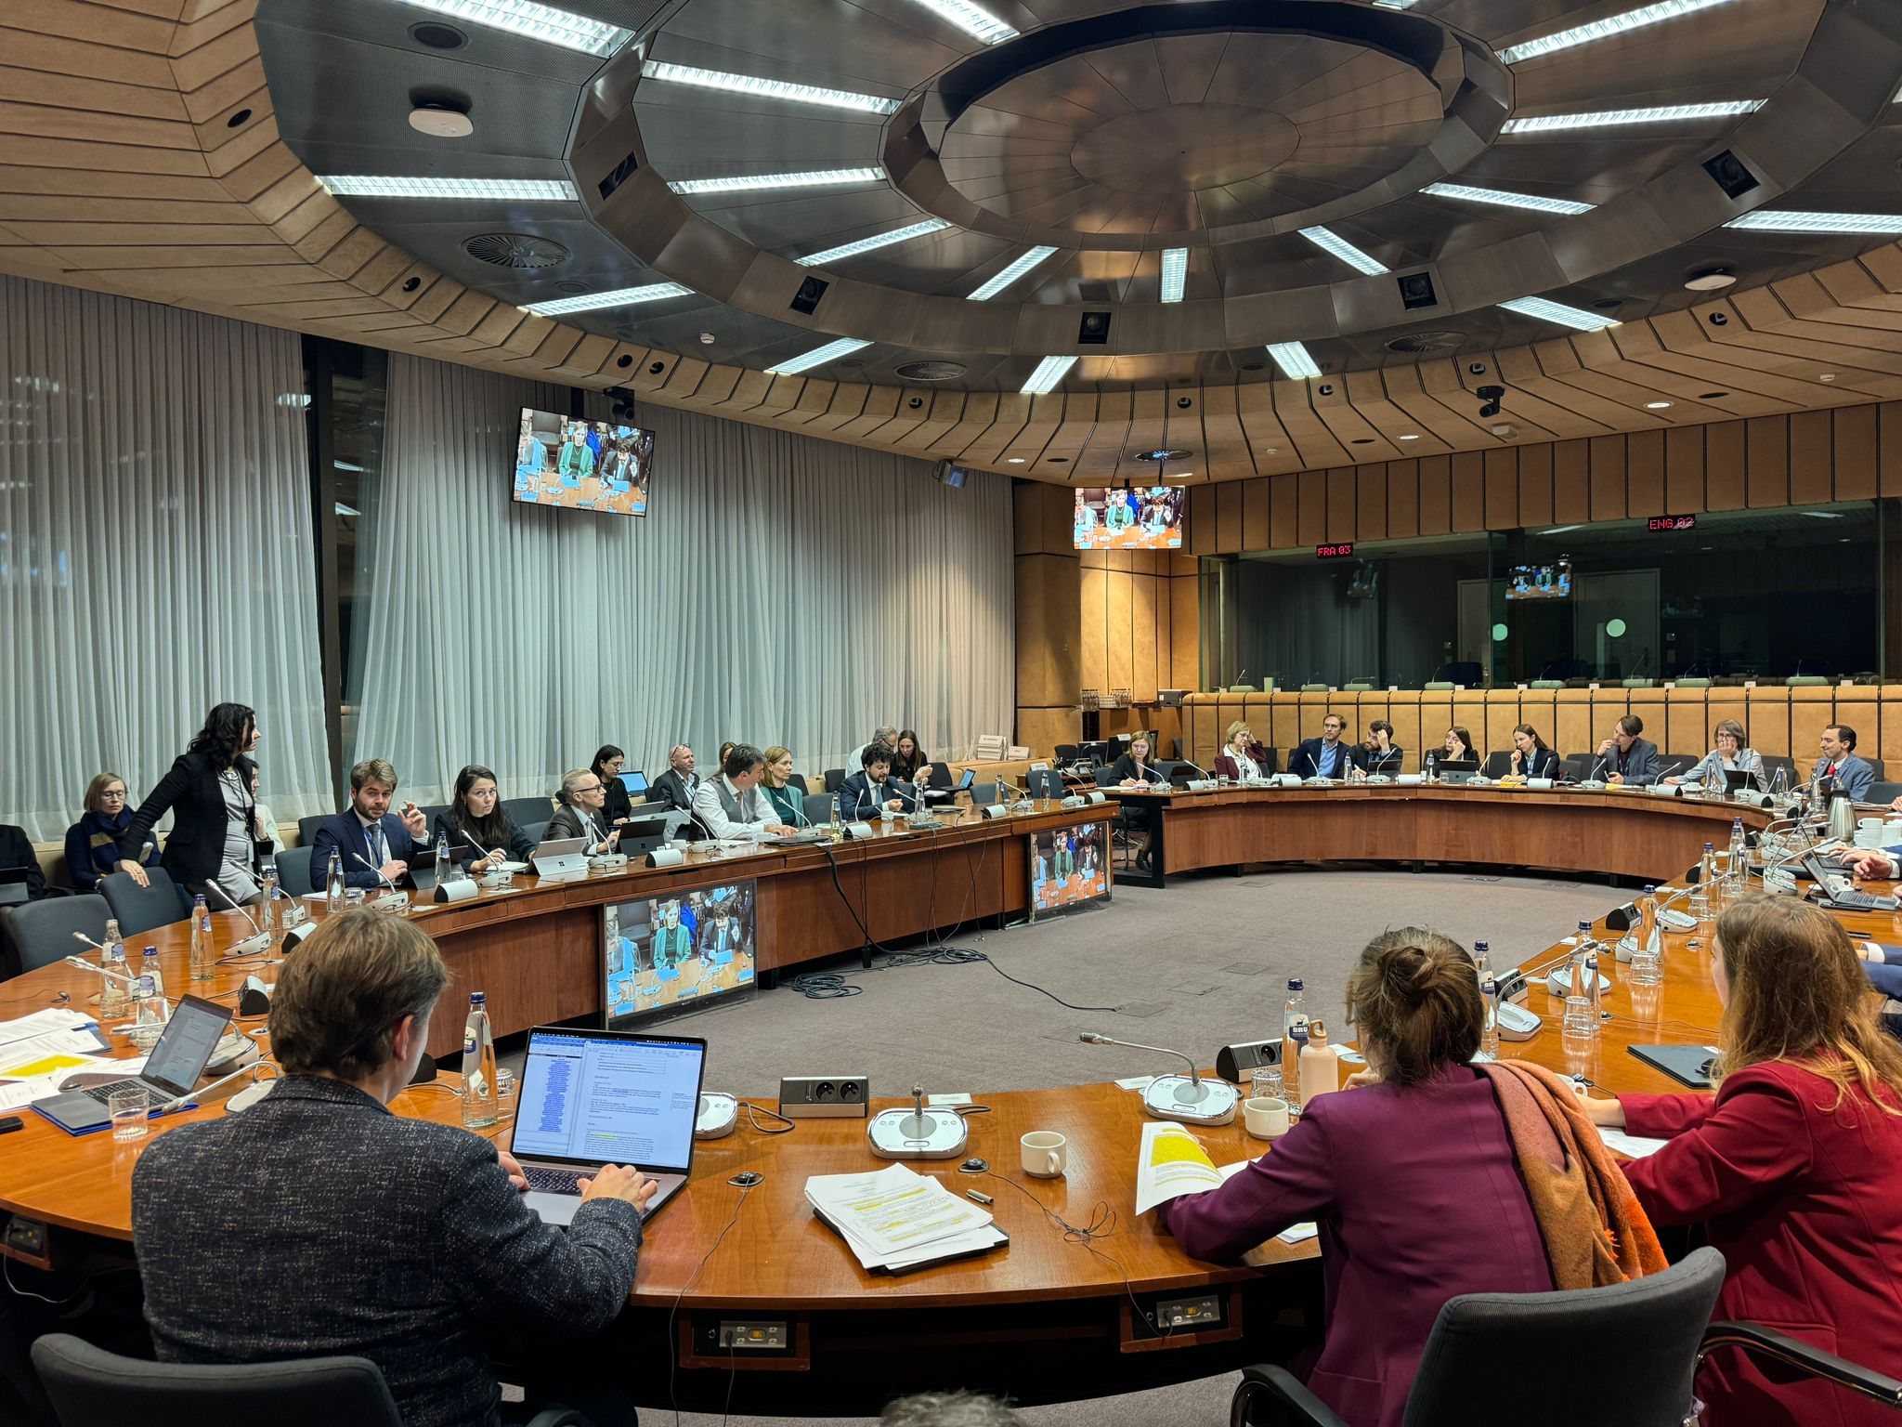

Slide 6
How do the
European Health Data Space
and the
Artificial Intelligence Act
interact?
Notes:
<Foliennummer>

Slide 7
1. Legal basis identical
TFEU Articles
16 data protection
114 internal market
not: 168 health, MS competence
both deal with data, incl. personal data
both regulate stuff brought on the market in the EU
Electronic Heath Records and AI systems

Slide 8
2. Legislative procedure similar
- European Parliament: joint committee procedure, Rule 58 of the RoP
EHDS: LIBE-ENVI
data protection, health
AIA: LIBE-IMCO
fundamental rights, internal market
COM, Council: only one lead each
EHDS: health, AIA: internal market

Slide 9
3. Differences
- EHDS part of the EU Data Strategy

Slide 11
3. Differences
EHDS part of the EU Data Strategy
COM Communication, 2020
„Data Spaces“ foreseen: industrial (manufacturing), Green Deal, mobility, health, financial, energy, agriculture, public administration, skills
plus Data Act (IoT data) and Data Governance Act („data altruism“)

Slide 12
3. Differences
AI Act builds on the „New Legislative Framework“:
adopted in 2008
unified rules for product safety
conformity assessments
market surveillance
CE label

Slide 13
4. A peek into the negotiations
„Health“ not a priority in the AIA
reference in Article 1:
“The purpose of this Regulation is to improve the functioning of the internal market and promote the uptake of human-centric and trustworthy artificial intelligence (AI), while ensuring a high level of protection of health, safety, fundamental rights enshrined in the Charter, including democracy, the rule of law and environmental protection, against the harmful effects of AI systems in the Union and supporting innovation.”

Slide 14
Health at risk by AI
Focus on risks to health, safety or fundamental rights by AI systems
human oversight
„high risk AI“ categorisation by amending Annex III, leading to additional obligations and safeguards

Slide 15
AI for health
Only in Article 59, personal data processing in regulatory sandboxes
„personal data lawfully collected for other purposes may be processed solely for the purpose of developing, training and testing certain AI systems (... for) public safety and public health, including disease detection, diagnosis prevention, control and treatment and improvement of health care systems”

Slide 16
AI for access to healthcare
„high risk AI“ under Annex III:
“AI systems intended to be used by public authorities or on behalf of public authorities to evaluate the eligibility of natural persons for essential public assistance benefits and services, including healthcare services, as well as to grant, reduce, revoke, or reclaim such benefits and services;”

Slide 17
Main conflicts in AI Act
bans on
remote biometric identification in public spaces
predictive policing
emotion recognition, incl. polygraphs
exeptions from „high risk“ categorisation
energy consumption reporting
general-purpose AI

Slide 18
EHDS does not refer to AI
... in any specific way.
few references in Recitals, e.g. (41): „training of artificial intelligence algorithms that could be used in healthcare or care of natural persons, as well as the evaluation and further development of existing algorithms and product for such purposes”

Slide 19
EHDS does not refer to AI
... in any specific way.
one reference in Article 34, secondary use: „training, testing and evaluating of algorithms, including in medical devices, in-vitro diagnostic medical devices, AI systems and digital health applications”
references to the European Artificial Intelligence Board, e.g. to ensure „common specifications“
interoperability of harmonised EHR components with AI systems: compliance rules

Slide 20
Main conflicts in EHDS
right to object to interoperable EHR
right to object to secondary use
parallel national health data systems
single data holders
scope of „scientific research“ – now including „development and innovation activities for products or services” – broader than Art. 9(2) GDPR

Slide 21
But EHDS will impact use of health data for AI training
EHDS rules on secondary use fully apply when the purpose is AI training
for details: Nikolaus Forgó

Slide 22
Questions?
ralf.bendrath@europarl.europa.eu
@bendrath@eupolicy.social
Notes:
<Foliennummer>

