Slide 1

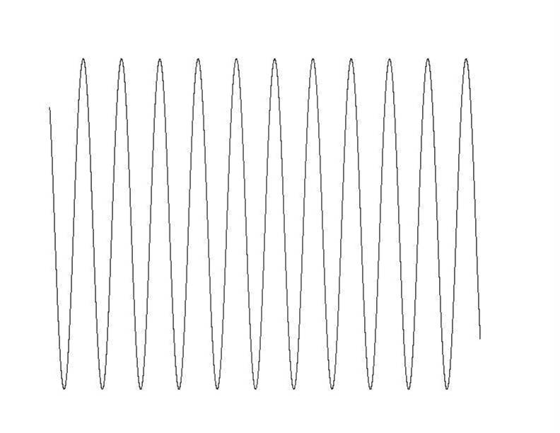
COSY
preparation
acquisition
dw
rf
rf
Number of data points , acquisition time -> spectral resolution
distance between points (dwell time) -> spectral range
2 * dw
rf
rf
3 * dw
rf
rf
number of increments , acquisition time -> spectral resolution
distance of increments (dwell time) -> spectral range

Slide 2
COSY , Two RF- pulses
90°
90°
t₁ δt increments
acquisition
δt dwell time
90°
90°
t₁ –evolution,
t₁ incremented
cos ω t₁
sin ω t₁
t₂ – evolution, acquisition M₊ = M_{x}+ i M_{y}
I_{x}- magnetization
sin ω t₁
sin ω t₁ (exp (i ω t₂ ))

Slide 3
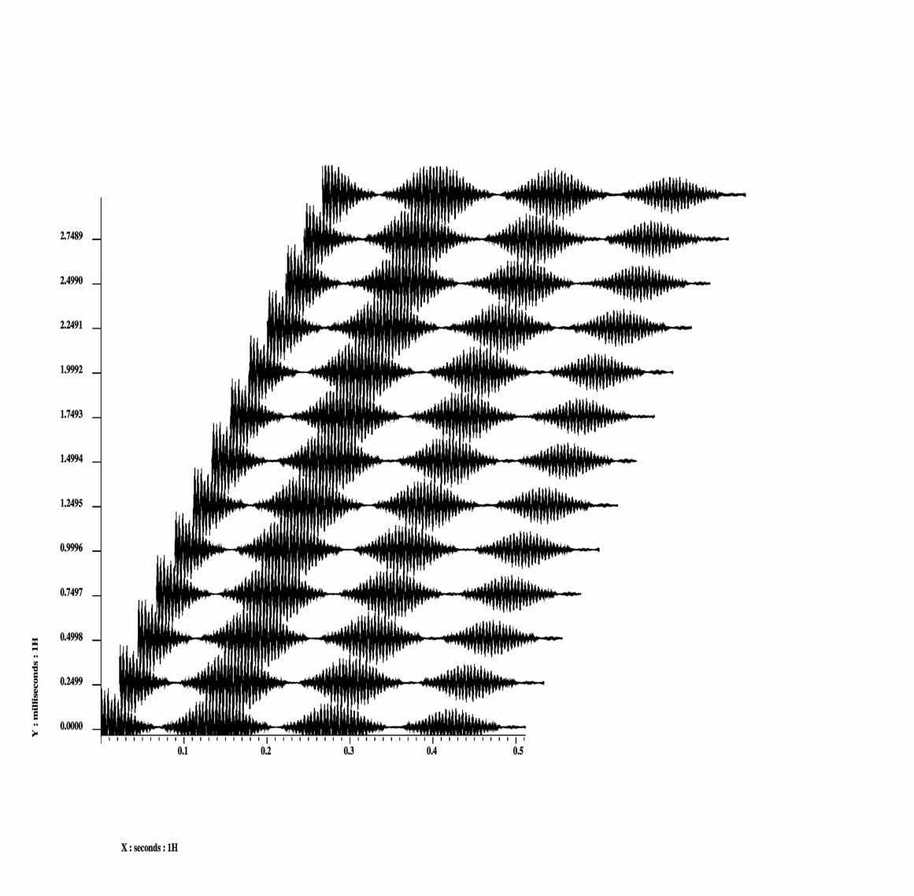
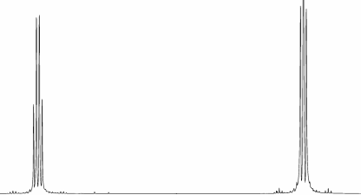
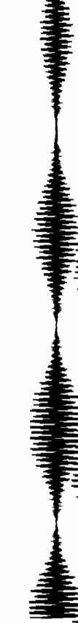
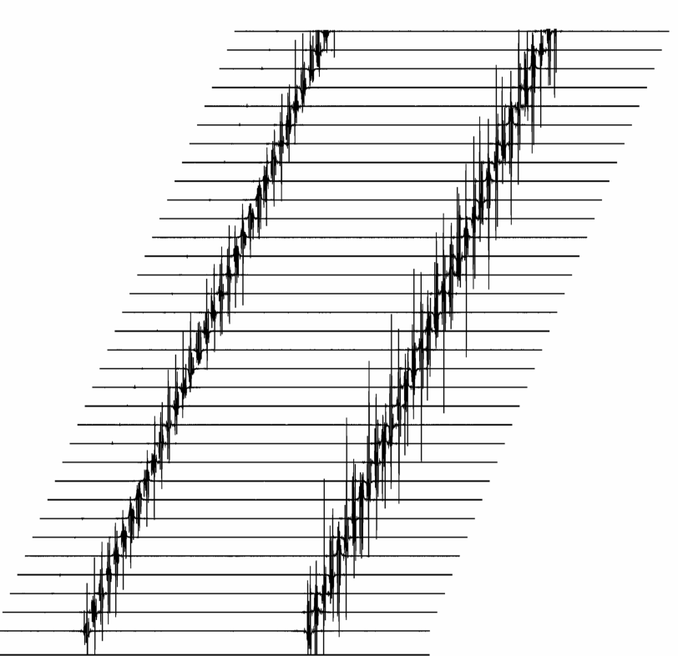
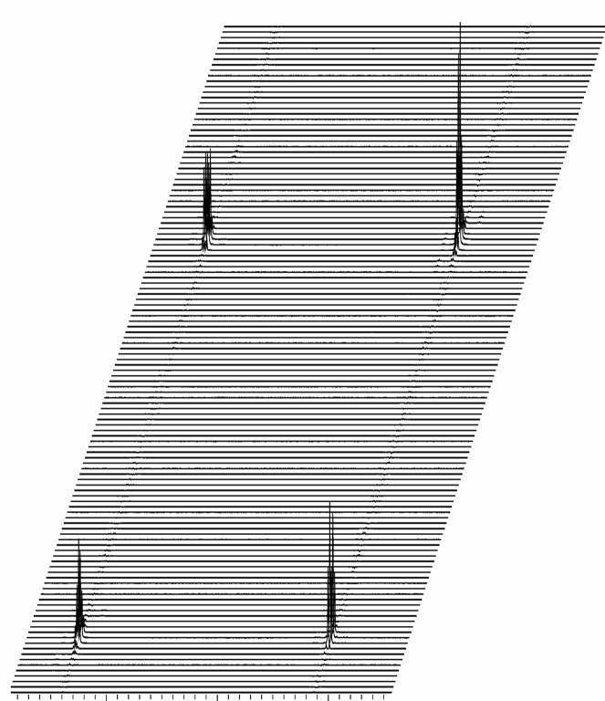
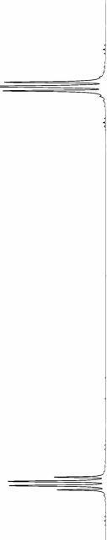
Two Frequency Axes
preparation λ = t₁ = n Δt
acquisition
t₁ has to be incremented
t₁
t₂
rf
rf
ω
ω
FT along t₂
FT along t₁
ω
t₁
t₁
(Sin ( ω t₁ ) Sin (J t₁ ) )
f₁
ω
ω
ω
t₂
f₂
f₂
sin ( ω t₁ ) exp ( i ω t₂ )

Slide 4
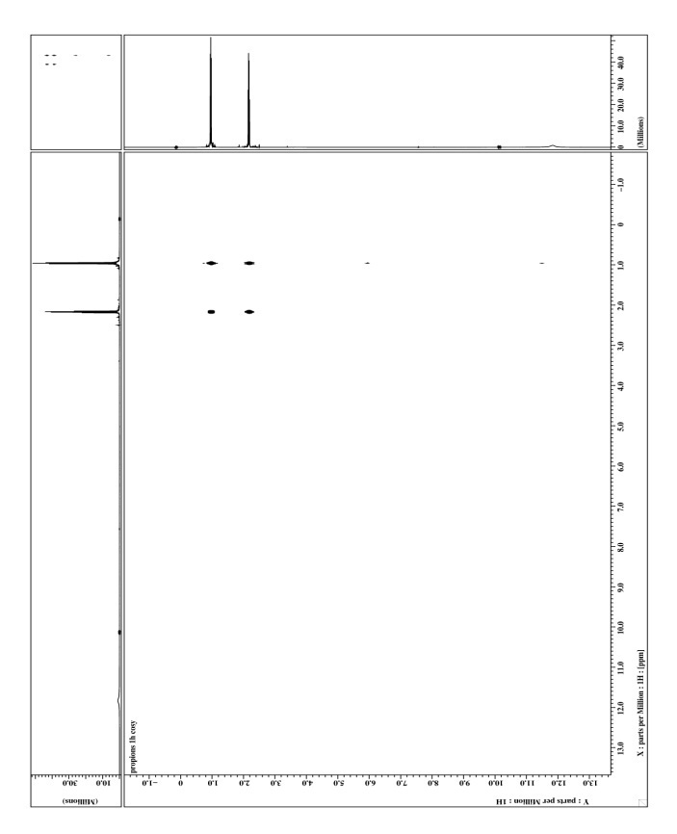
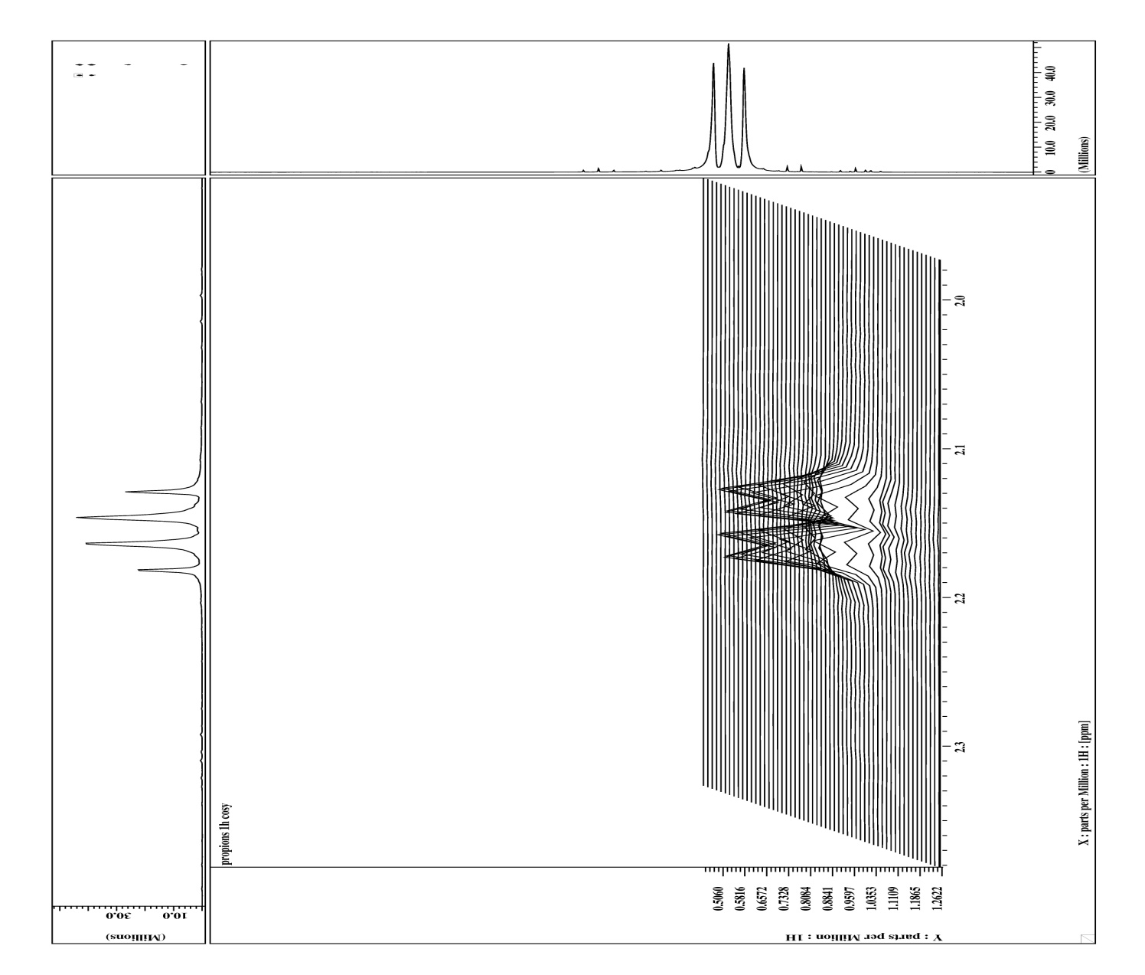
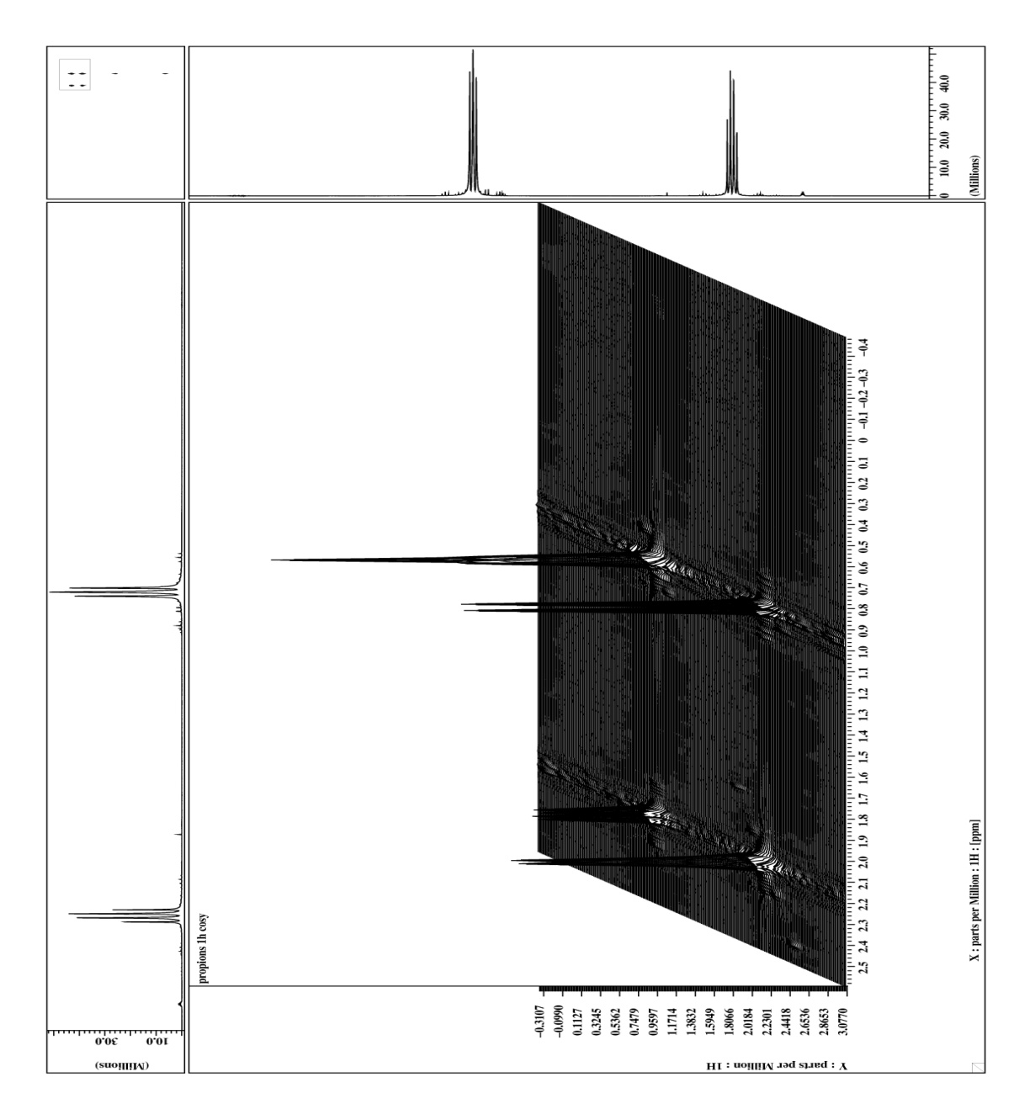
COSY- Experiment (¹H, ¹H)
COSY – Experiment (¹H, ¹H)
90°
90°
t₁ incremented
t₂ acquisition
propionic acid

Slide 5
COSY Cross Peaks
chemical shift COrrelation SpectroscopY COSY
H
H
Reveals scalar coupling network
H
90°
90°
t₁ incremented
acquistion
H
Cross peaks connect coupling protons

Slide 6
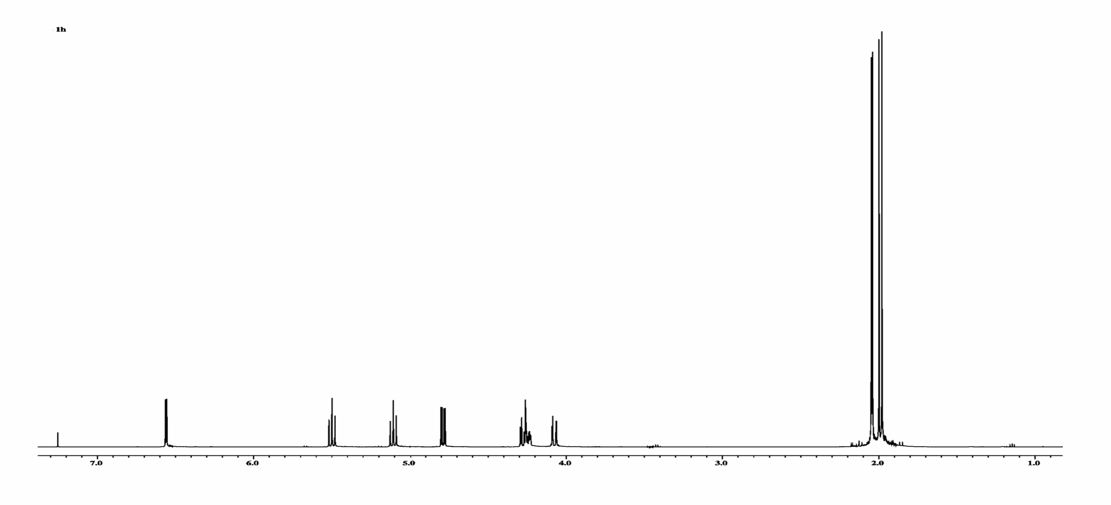
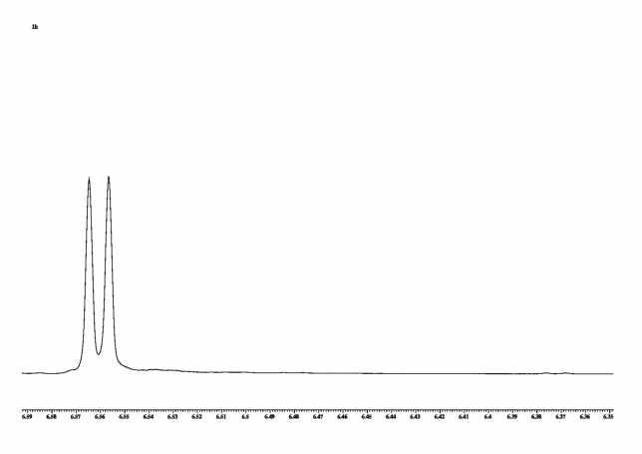
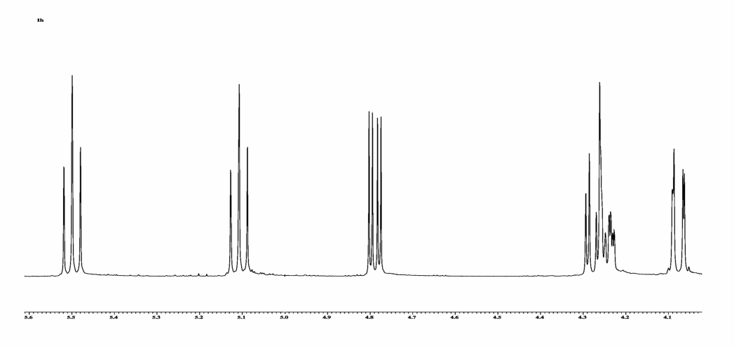
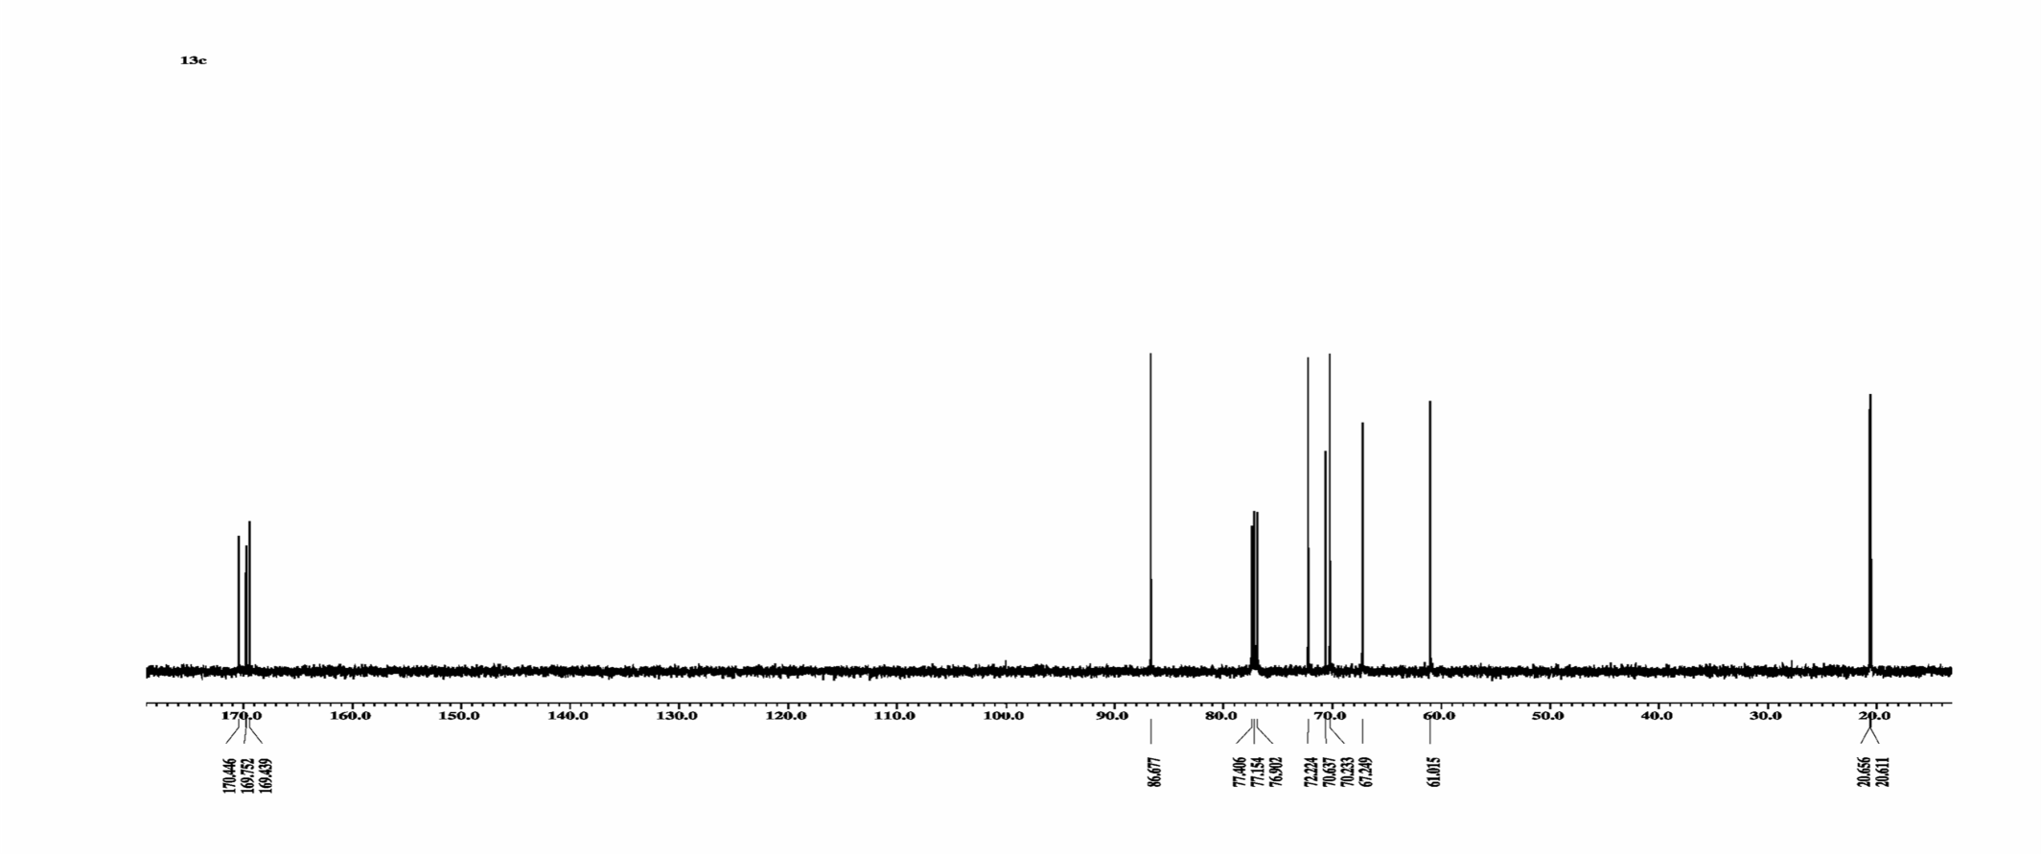
Beispiel Zuckerderivat ¹H-Spektrum
Glucose Derivative ¹H ,¹³C
4 ∗ 3
application
1
1
1
1
2
1
13C-Spectrum
4 CH
CH2
4 CH3
4 q C
CH

Slide 7
Beispiel Zuckerderivat ¹H-Spektrum
Dept Spectra
4 ∗ 3
Distortionless Enhancement by Polarisation Transfer DEPT
13C-Spectrum
4 CH
CH2
4 CH3
4 q C
CH
DEPT 135
DEPT 45
DEPT 90

Slide 8
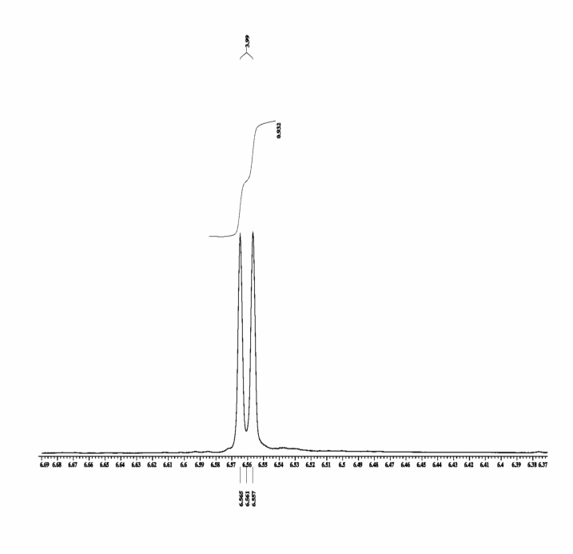
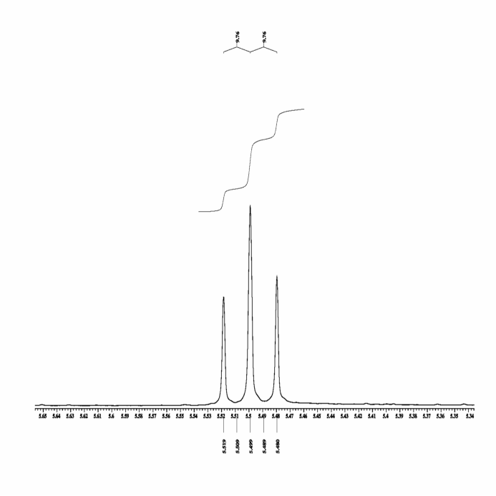
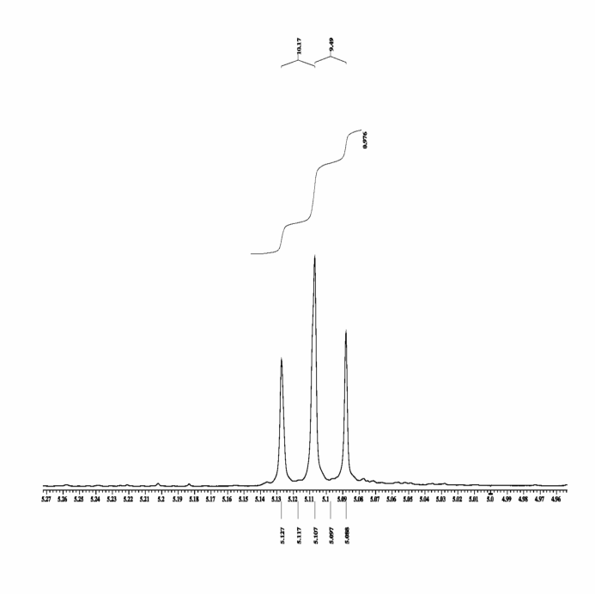
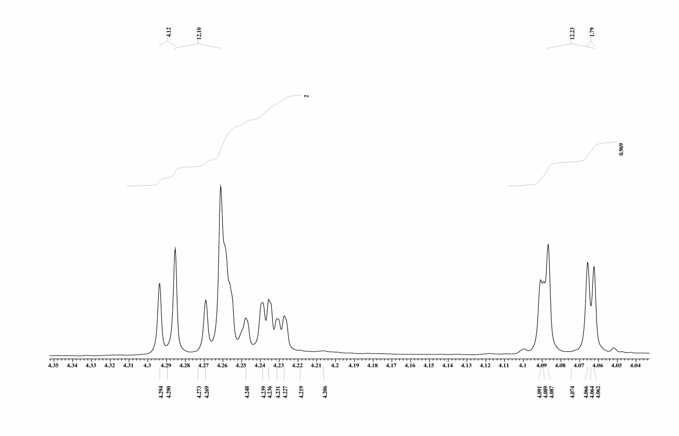
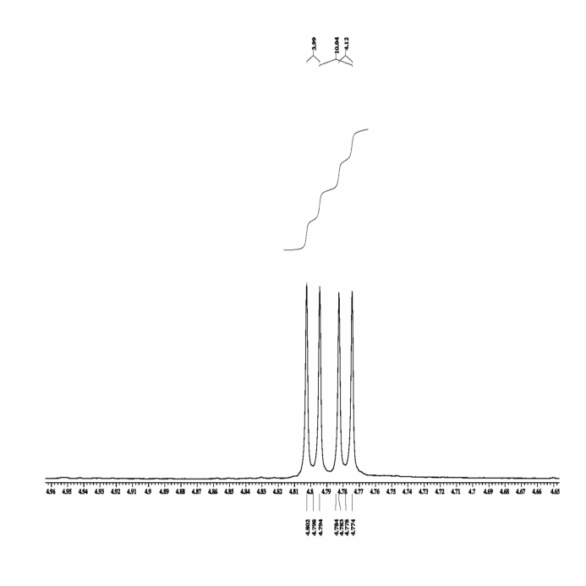
H –H Coupling Constants
Coupling partners cannot be assigned unambiguously
4.0
9.8
9.8
10.2
9.8
0.99
0.98
0.98
4.1
12.1
12.2
1.8
4.0
10.0
4.1
2.00
0.97
0.97

Slide 9
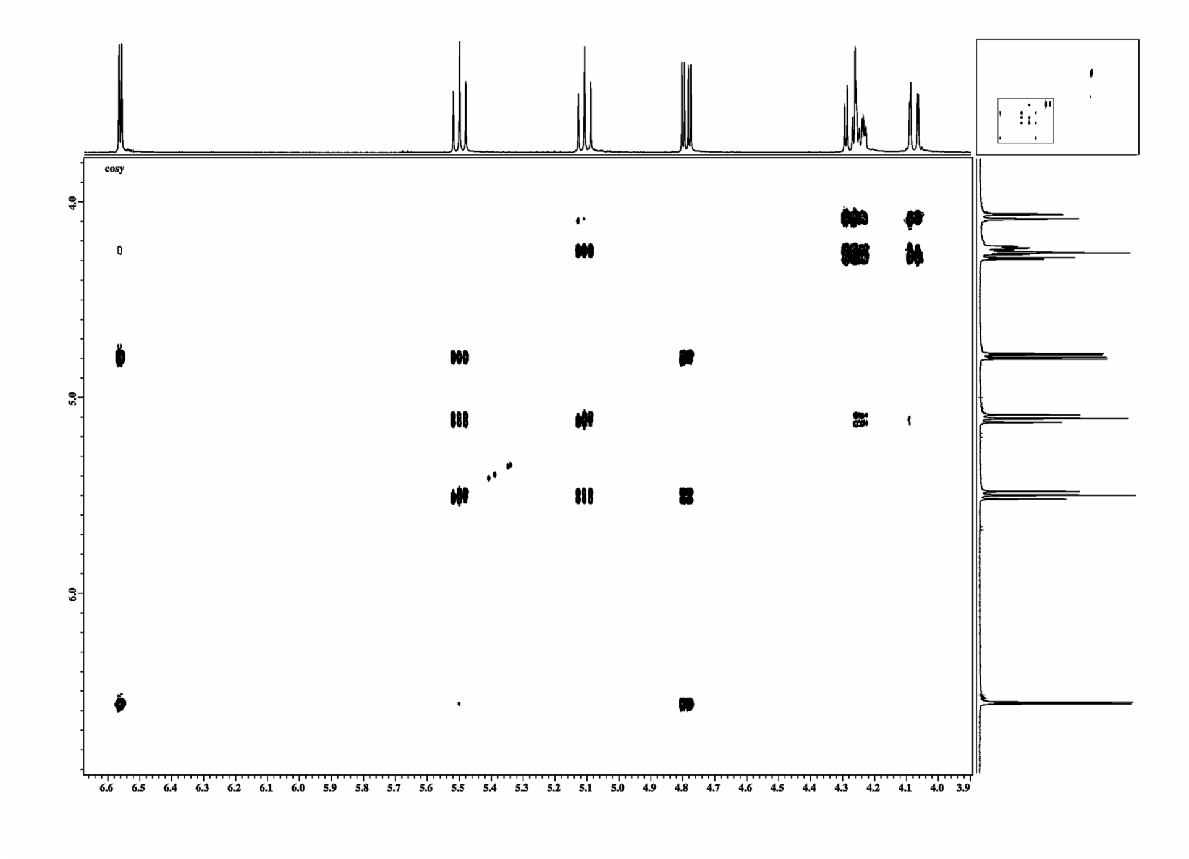
Glucose Derivative COSY
6´
O
C
H
O
C
H
O
C
H
O
C
H
O
C
H
H
C
H
O
Cross peaks indicate coupling protons.
1
2
3
4
5
6
1
3
4
2
6´
5
6
6
5
6´
2
4
3
1

Slide 10
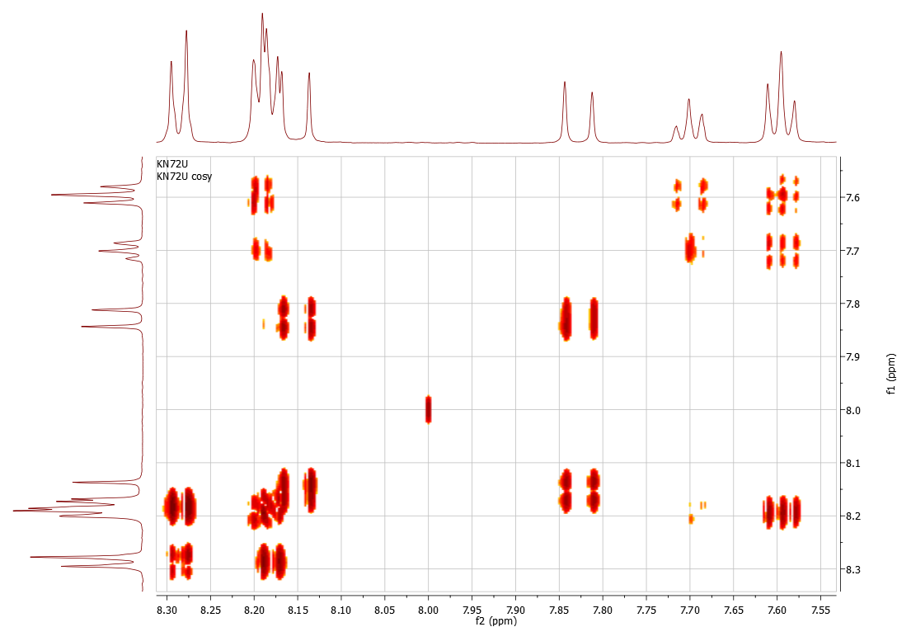
Processing
Resolution differ in both dimensions
Resolution better
Resolution worse
Resolution better

Slide 11
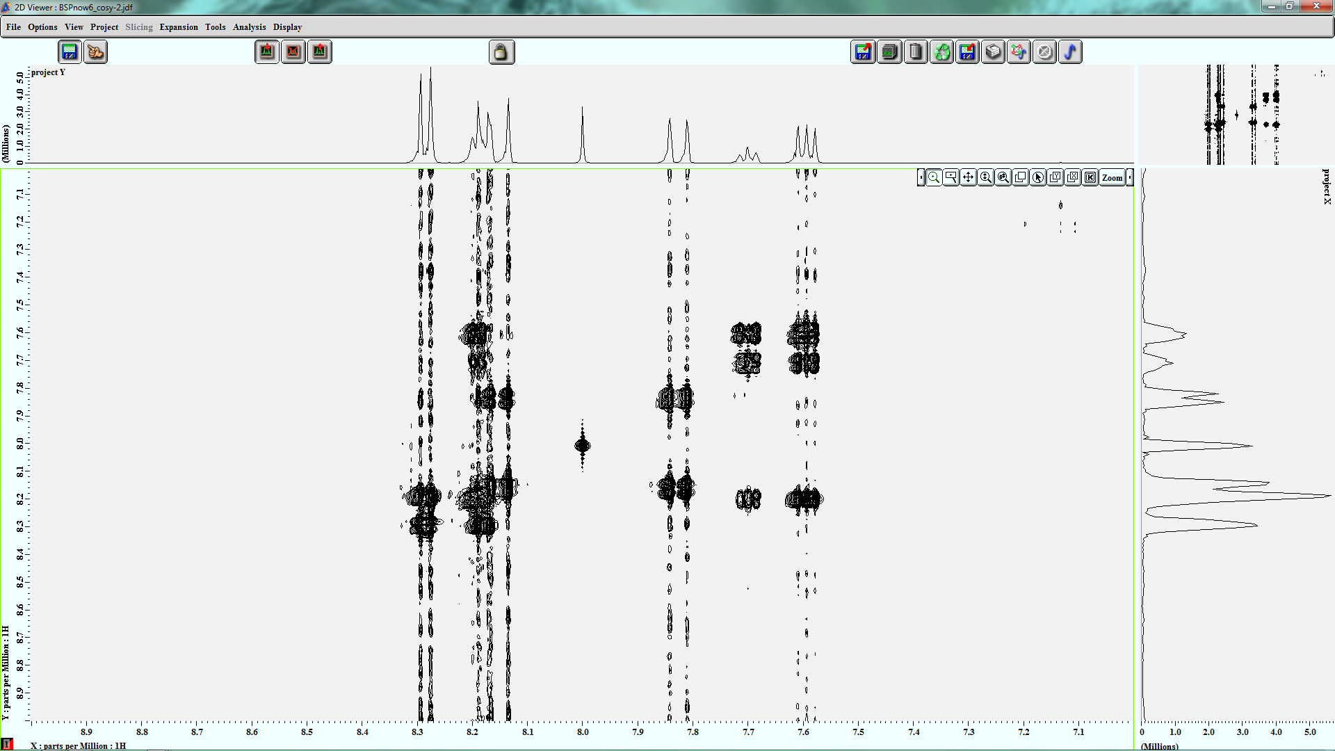
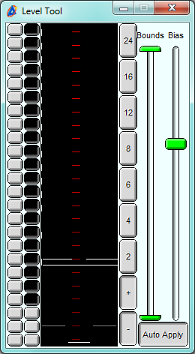
Processing
contour plot levels can be adjusted
t1 noise

Slide 12
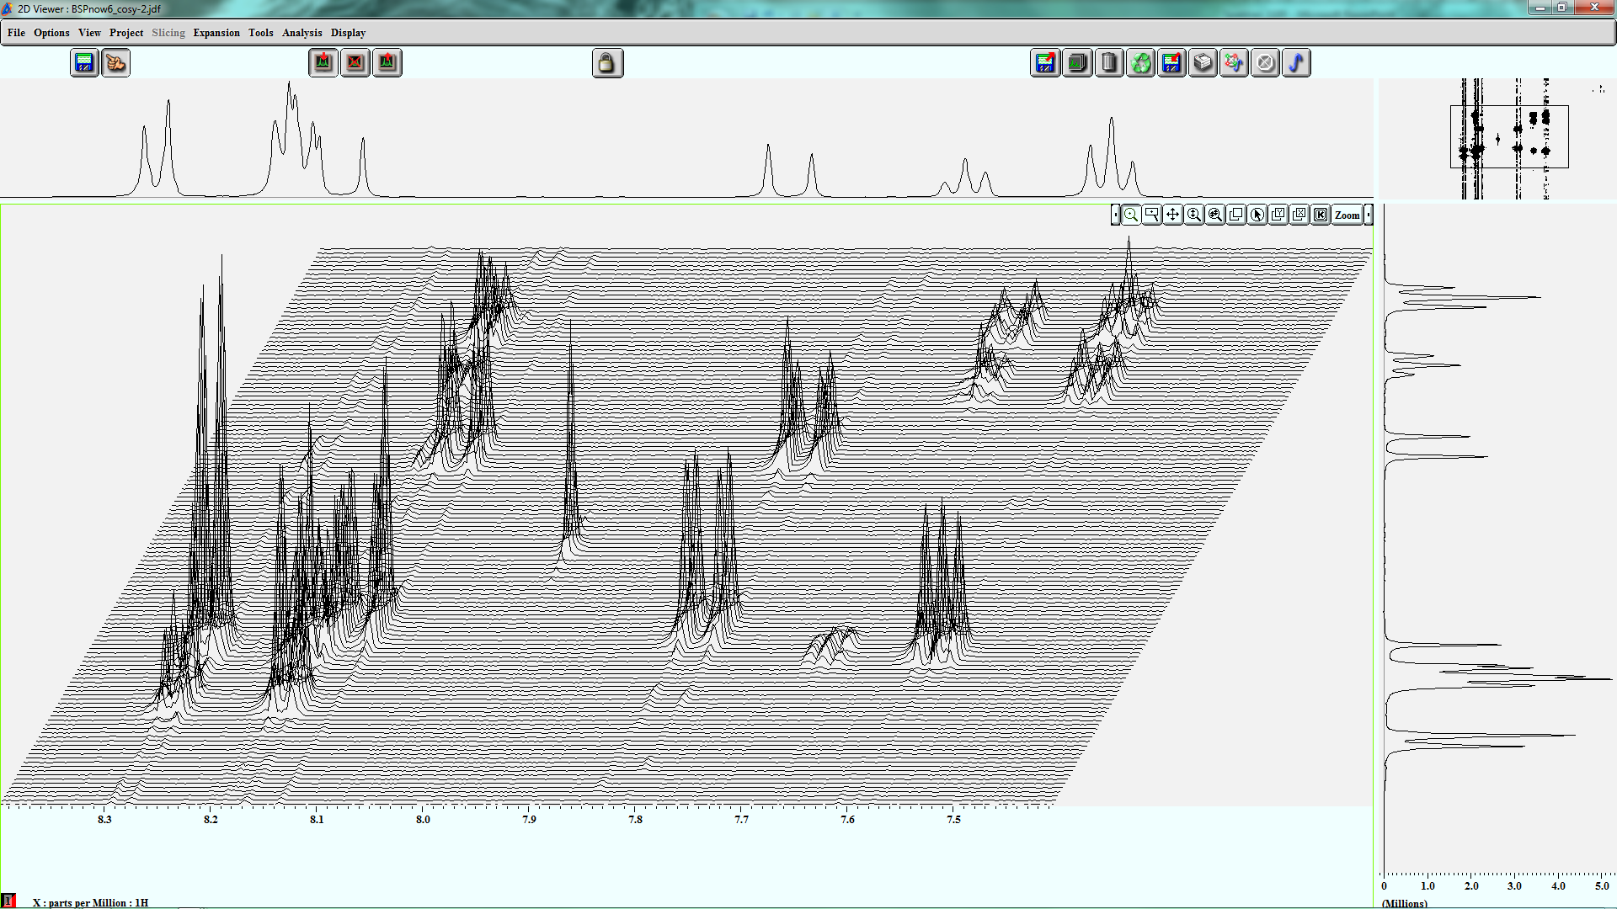
Processing
stack plot

Slide 13
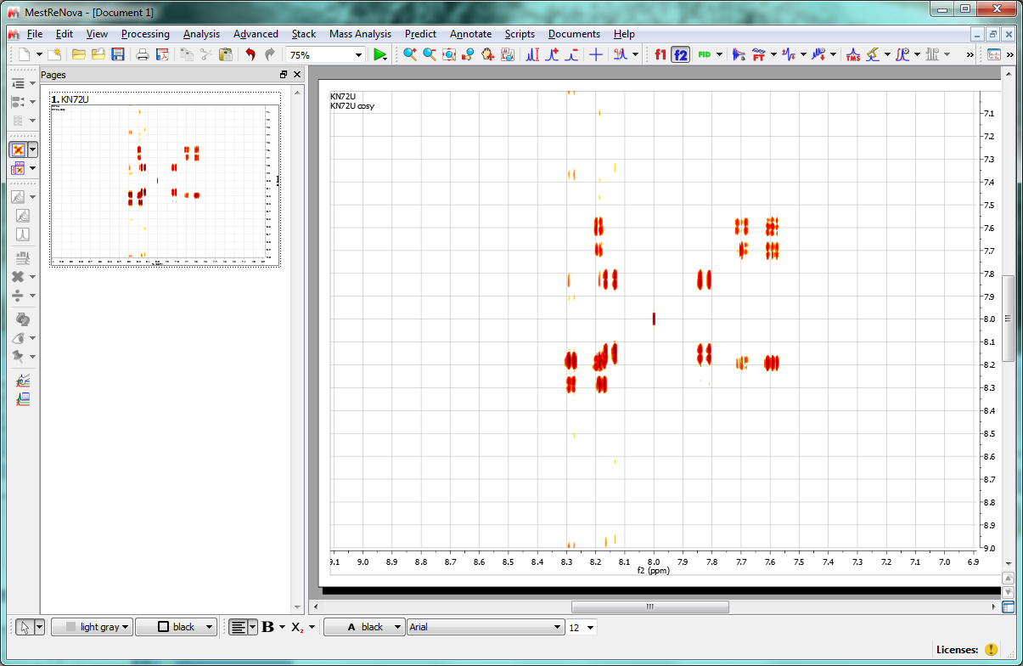
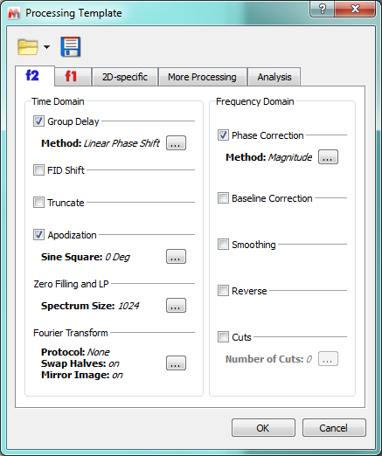
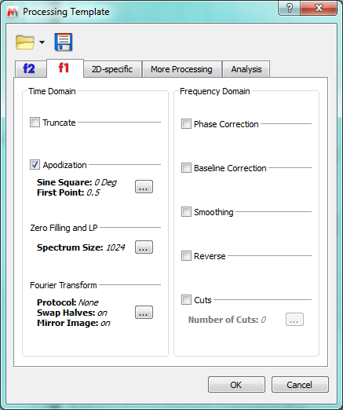
Processing
Templates can be created and stored.
different processing in both dimensions

Slide 14
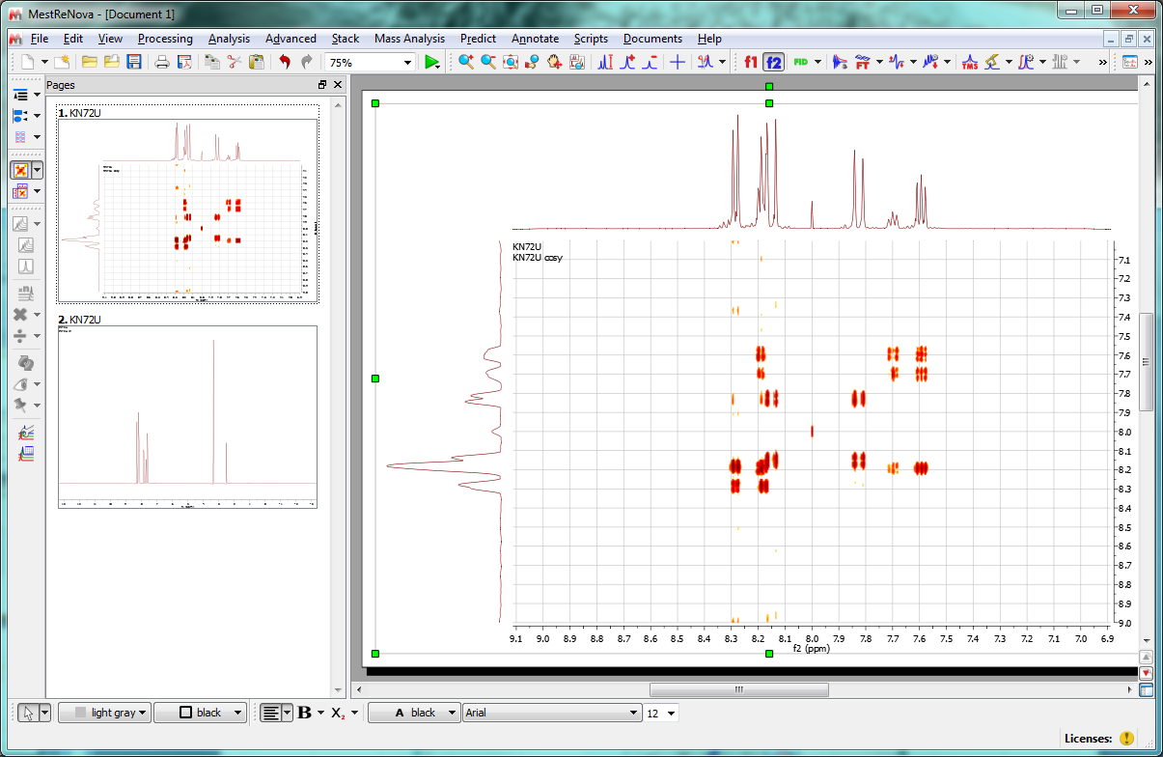
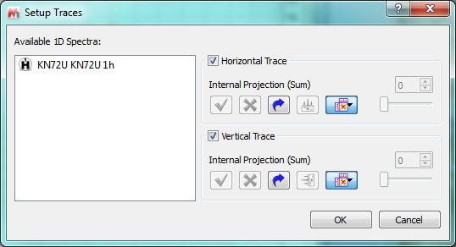
Processing
Load external projections; choose from list

Slide 15
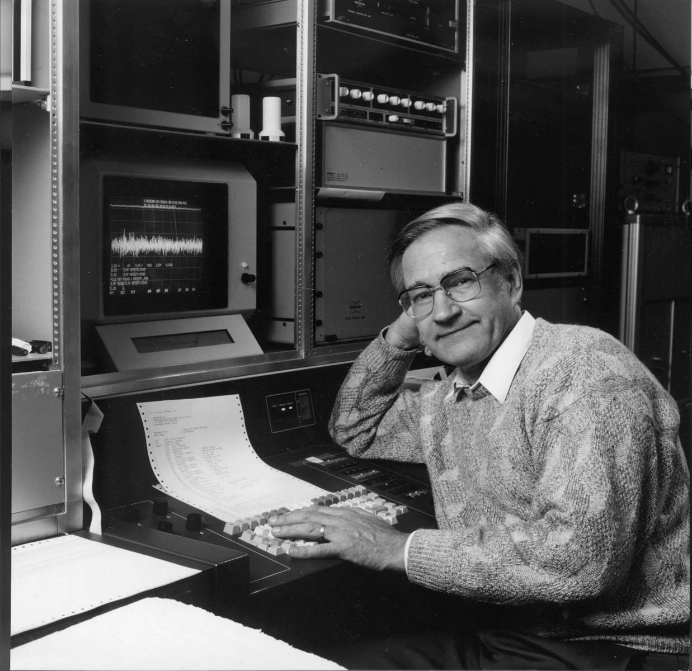
Nobel Laureate 1991
Richard Ernst Nobel laureate 1991

