Slide 1
Current
Digital Legislation
in the EU
Ralf Bendrath
Adviser for
civil liberties, justice and home affairs
Greens/EFA in the European Parliament
Notes:
<Foliennummer>

Slide 2
My background: #EudataP

Slide 3
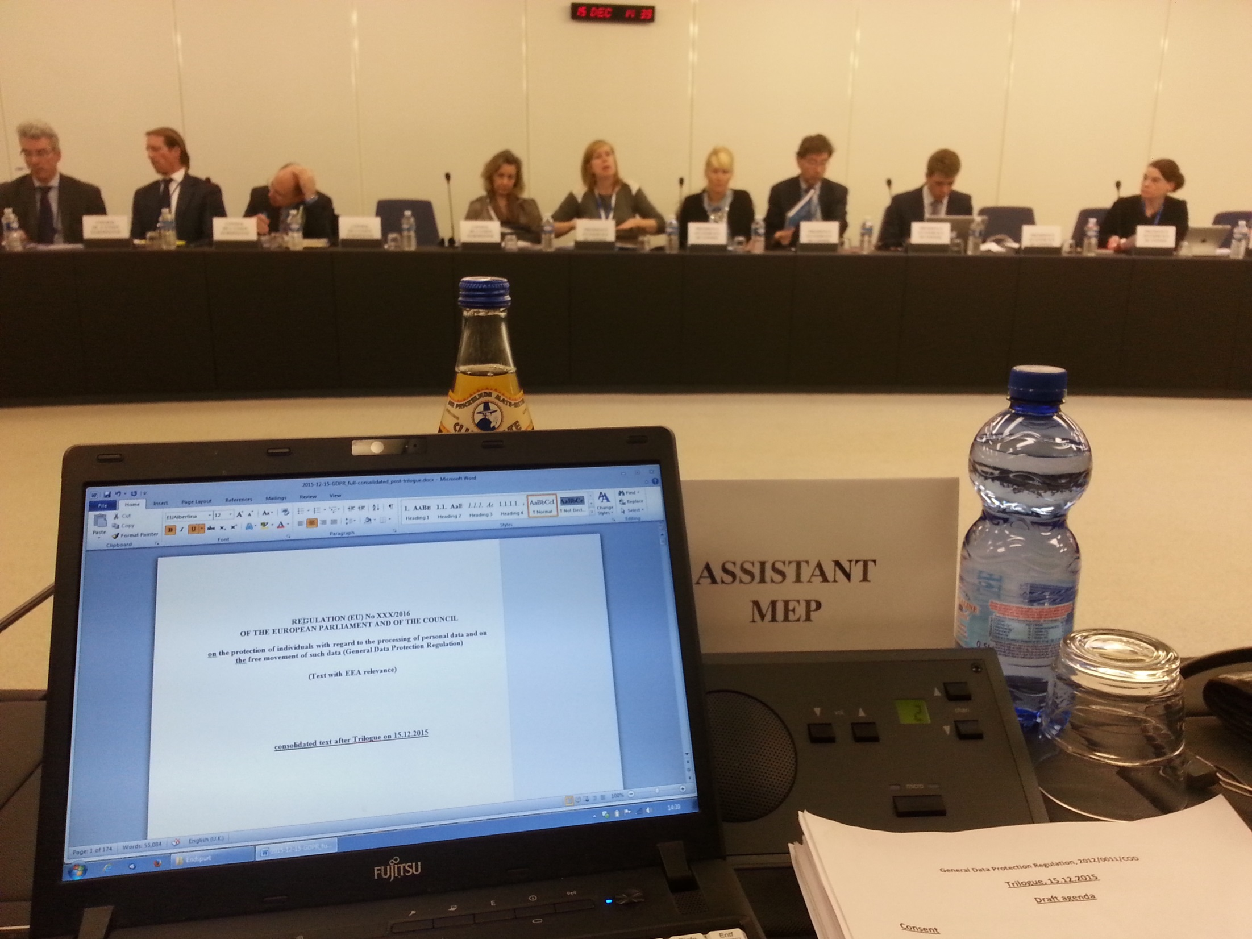
Notes:
<Foliennummer>

Slide 4
What is now going on?
Data protection / Privacy
Platforms
Data
Identity
Digital currency
Security
Cyber
Notes:
<Foliennummer>

Slide 5
1. Data protection / Privacy

Slide 6
Data protection / Privacy
e-PrivacyRegulation
- modernising the 2009 Directive
- COM proposal from 10th January 2017
EP-position, October 2017
Council position, February 2021
Trilogue stuck

Slide 7
Data Protection / Privacy
Child Abuse Scanning / „chat control“
Temporary derogation from e-Privacy (2021)
Comprehensive Regulation now
"Mass scanning illegal" (several legal services)
In the middle of negotiations right now

Slide 8
2. Platforms

Slide 9
Digital Services Act (DSA)
e-Commerce Directive: Hosting
Now: Recommender algorithms
Result mixed, but better than nothing
Relevant for hate speech / disinfo, but not only

Slide 10
Platform Regulation
Digital Markets Act
for gatekeepers
Terrorist Content Online
2020, went well, but...
cross-border..
Political Advertising
Almost done, but again no full ban

Slide 11
3. Data

Slide 12
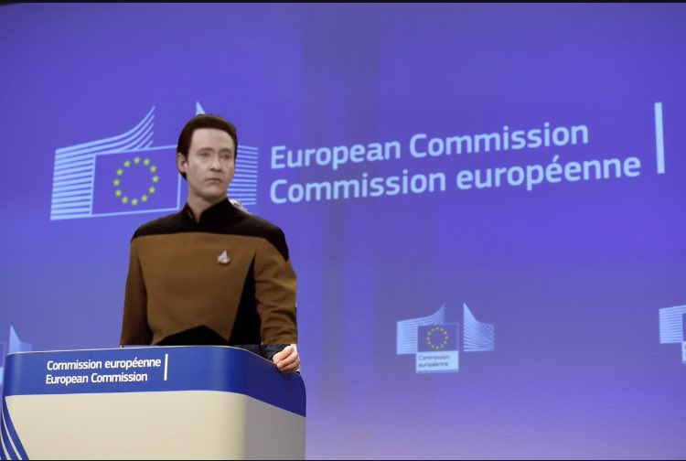
EU Data Strategy

Slide 13
Data Strategy
Data Governance Act (done)
- Rules for data altruism
Data Act (done)
Obligations for IoT providers that have data
Personal Data → GDPR

Slide 14
Data Strategy
Specific "data spaces"
- EU health data space
secondary use of your patient file?
- Financial Data Space
- Transport Data Space
etc.

Slide 15
Data Strategy
Data adequacy decisions for non-personal data
- If third countries don’t give us access to their data on the same terms, we don’t give them access to our EU data
- Part of a larger conversation on the global data economy and trade system

Slide 16
4. "Artificial Intelligence"

Slide 17
AI Act
Market Approval for AI Systems
Risk too high → banned
High risik → regulated
Low risk → allowed anyhow
New Legislative Framework
CE labels for software systems?
Criteria for risk assessments
More recently: Large language models
- toxic mushrooms

Slide 18
5. Identity

Slide 19
eID
digital signature and certificates
wallet
privacy by design?
Domain-specific pseudonyms?

Slide 20
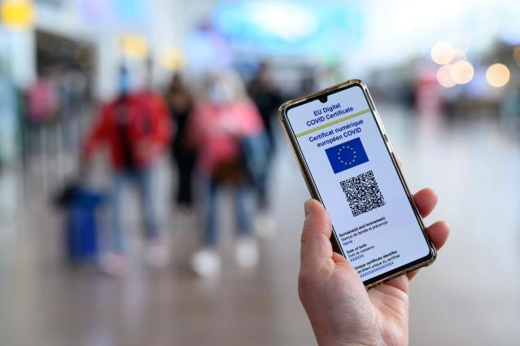
digital Covid-19 certificate

Slide 21
6. Digital Money

Slide 22
Digital Euro
Central-Bank Digital Currency
Not: blockchain / crypto scam
Offline payments
Holding limit
Architecture unclear (chosen by ECB)

Slide 23
7. Security

Slide 24
Police information exchange
Prüm II, Europol, e-Evidence, ...
Loads of other files
→ We mostly against because of more data sharing without necessity proof
→ Europol had kept 80 petabyte of personal data illegally
- cross-border issue
But: We fully support Eurojust and investigations of war crimes in Ukraine

Slide 25
7. Cyber

Slide 26
Cyber
Network & Information Security, Rev. 2
Nice, but again:
No minimum standards
No product liability for software
European cyber resilience act
- on-going
- my colleagues tell me it’s bad

Slide 27
Questions?
ralf.bendrath@europarl.europa.eu
@bendrath@eupolicy.social
Notes:
<Foliennummer>

